Slide 1

Group I project scrum/Report-out
Deran Cross, Zifran Chowdhury, Ikechukwu Ogowui, Emmanuel Dairo

Slide 2
Quick Recap
The Problem: Household food waste and stressful meal planning
Our Solution: KitchenSync, an inventory tracking and recipe web app
Core MVP Features:
Allow users to input and track their food items.
Receive automated expiry notifications.
Generate, browse, filter, and save recipes based on inventory.

Slide 3
Project Planning
Scope & Requirements: Delivering an MVC web application within a two-month timeframe and chosen tech stack (MongoDB/Mongoose, HTML/CSS/EJS, Node.js/Express, Desktop/Mobile compatibility)
Team Roles and Responsibilities: Dividing up tasks and technical duties
Deran: Product Manager, Scrum Master
Zifran: Backend Engineer, Quality Assurance
Ikechukwu: Full-stack Developer
Emmanuel: Full-stack Developer
Agile Approach: Using a GitHub Kanban board to track features, user experiences, and overall MVP progress

Slide 4
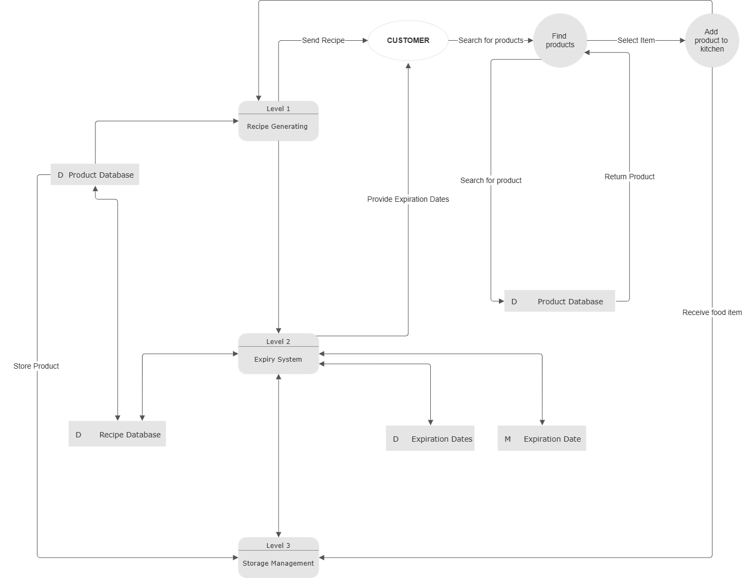
Data Flow Diagram
.

Slide 5
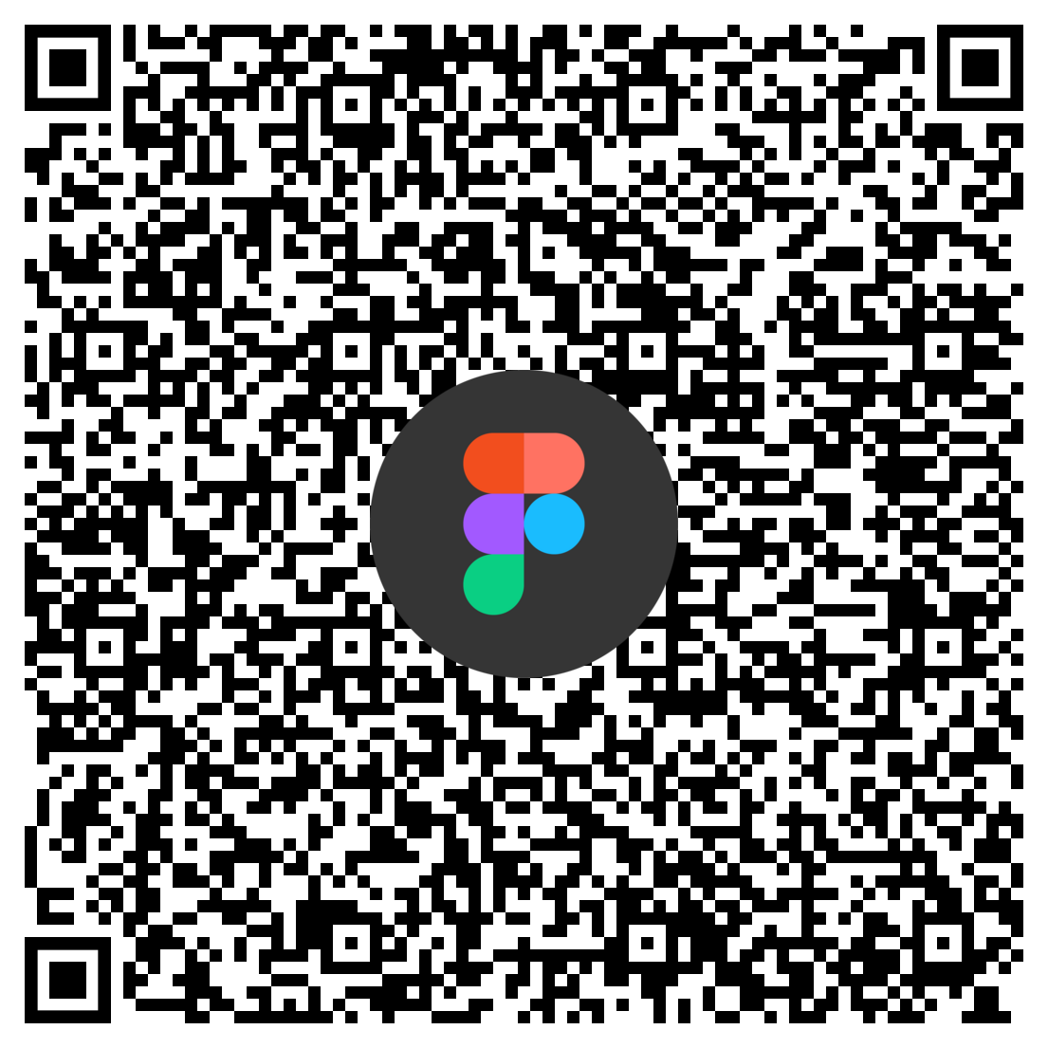
Our Hi-fi Prototype
Click to open

Slide 6
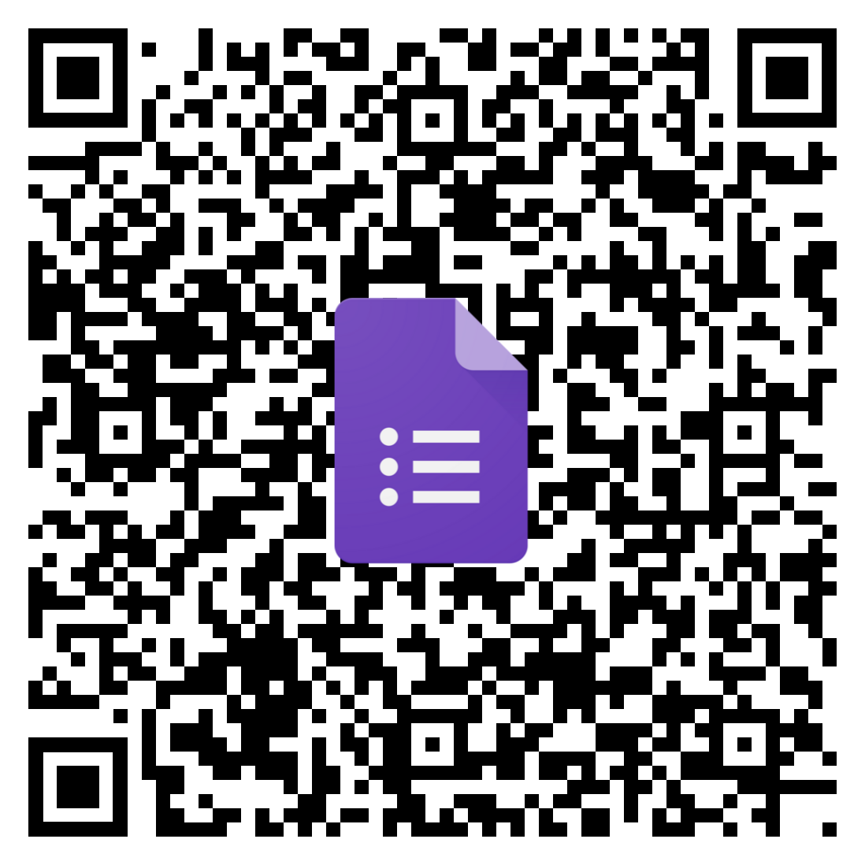
User Questionnaire

Slide 7
Team Reflection
Overall Feelings:
Enjoyed creating the visual look/UI prototypes, including Lo-fi sketches and Hi-fi design
Challenged by the learning curve of MVC architecture and tech stack
Proudest Accomplishment:
Successfully mapping out the app's features/system boundaries in our UML diagram
Lessons Learned:
The importance of documentation and clear communication
Moving Forward:
Relying on our Kanban board and diagrams to guide our daily coding tasks
Areas For Help:
Connecting the visual app to our database, especially to get the recipe suggestions working smoothly

Slide 8
Thanks For Participating!
Any Questions?

